Slide 1
ATTRITION RATE PREDICTIONS FOR BUSINESS GROWTH
Machine Learning Final Review
By-
Amulya Boyapati - 17BCE0040
A.Rithwik Vamshi - 17BCE2087
Ala Sree Advaith - 17BCE0104

Slide 3
Thank you

Slide 4
Introduction
Customer attrition is one of the most important metrics for a growing business to evaluate. It shows the loss of clients or customers. Customer churn is a critical metric because it is much less expensive to retain existing customers than it is to acquire new customers.
Our Motivation is to find the Teleco Customers who are more likely to unsubscribe from Telco service and retaining them rather than loosing
This is not only restricted to the Telco industry but also for the bank sector, entertainment sector etc.

Slide 5
Scope
Ø To infer the factors which influence the customers most.
Ø Usage of Machine Learning algorithms like Linear Regression, Logistic Regression, Random Forest etc., to predict the churn of the future customers
Ø Models built using train datasets are tested through the test dataset. Accuracy and error rate are used to understand how these models are behaving for the test dataset.
Ø So that it would be helpful to the companies to improve their services and retain the original customers and attract the original customers.

Slide 6
Three main strategies have been proposed to generate more revenues
(1) acquire new customers,
(2) upsell the existing customers, and
(3) increase the retention period of customers.

Slide 7
Gaps Identified
All the research papers so far discussed have been giving a detailed analysis of how churn has been changing over every year but in contrast, we are doing a detailed analysis of each and every attribute present in the dataset on which it has effect in changing of churn and also through over-analysis and through our visualization the company can understand which factors influence the customer to change the company network.

Slide 8
Dataset Description
Customers who left within the last month – the column is called Churn
Services that each customer has signed up for – phone, multiple lines, internet, online security, online backup, device protection, tech support, and streaming TV and movies
Customer account information – how long they’ve been a customer, contract, payment method, paperless billing, monthly charges, and total charges
Demographic info about customers – gender, age range, and if they have partners and dependents

Slide 9
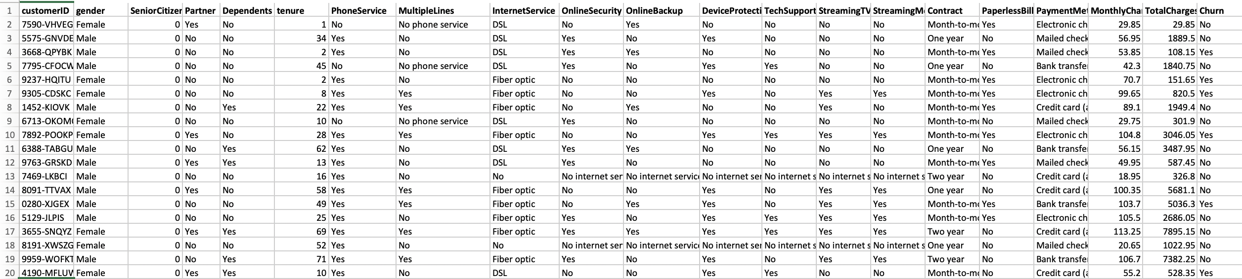
SAMPLE DATA

Slide 10
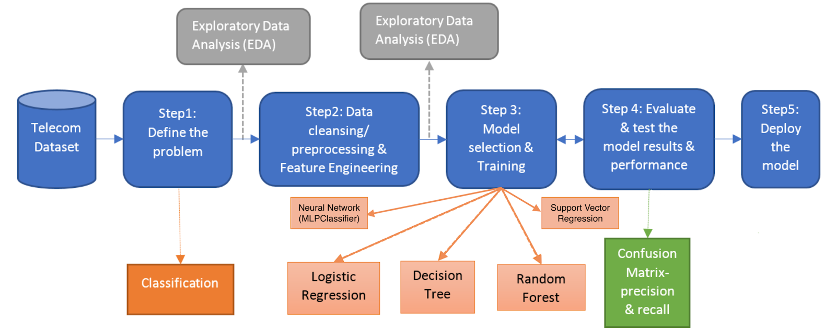
Architecture

Slide 11
Architecture
Step 1: Telecom dataset has the details for 7000+ unique customers, where details of each customer are represented in a unique row and below is the structure of the dataset.
Step 2: Data cleansing and preparation will be done in this step. Transforming continuous variables into meaningful factor variables will improve the model performance and help understand the insights of the data.
Step 3: In the predictive modeling, the data need to be partitioned into train and test sets. 70% of the data will be partitioned for training purposes and 30% of the data will be partitioned for testing purposes.
Step 4: Models built using train datasets are tested through the test dataset. Accuracy and error rate are used to understand how these models are behaving for the test dataset.

Slide 12
Algorithms
1.Logistic Regression: Logistic regression is a supervised learning classification algorithm used to predict the probability of a target variable. Logistic regression becomes a classification technique only when a decision threshold is brought into the picture. The setting of the threshold value is a very important aspect of Logistic regression and is dependent on the classification problem itself.
2.Decision Tree: A decision tree is a flowchart-like structure in which each internal node represents a test on a feature, each leaf node represents a class label and branches represent conjunctions of features that lead to those class labels. The paths from root to leaf represent classification rules.

Slide 13
Algorithms
3.Random Forest: Random forest algorithm creates decision trees on data samples and then gets the prediction from each of them and finally selects the best solution by means of voting. It is an ensemble method which is better than a single decision tree because it reduces the over-fitting by averaging the result.Each individual tree in the random forest spits out a class prediction and the class with the most votes becomes our model’s prediction
4.Support vector regression: The Support Vector Regression uses the same principles as the SVM for classification, with only a few minor differences. A margin of tolerance (epsilon) is set in approximation to the SVM which would have already been requested from the problem. There is also a more complicated reason, the algorithm is more complicated therefore to be taken in consideration.

Slide 14
Algorithms
5.Neural Network:
Neural Networks are a class of models within the general machine learning literature. Neural Networks are themselves general function approximations, which is why they can be applied to a problem about learning a complex mapping from the input to the output space.
Neural networks can be created from at least three layers of neurons:
The input layer, the hidden layer(s) and the output layer. The hidden layer — or layers — in between consist of many neurons, with connections between the layers. As the neural network “learns” the data, the weights, or strength, of the connections between these neurons are “fine-tuned,” allowing the network to come up with accurate predictions.

Slide 15
Experimental Setup
We used Google colab platform to run our project. These are the libraries used during the runtime
1. Pandas: We can analyze data in pandas with Series & Data Frames
Series is one dimensional(1-D) array defined in pandas that can be used to storeany data type.
DataFrames is two-dimensional(2-D) data structure defined in pandas which consists of rows and columns.
2. Numpy: It is a general-purpose array-processing package. It provides a high-performance multidimensional array object, and tools for working with these arrays.In Numpy, the number of dimensions of the array is called rank of the array.
3. Matplotlib.pyplot: Matplotlib comes with a wide variety of plots. Plots helps to understand trends, patterns, and to make correlations. They’re typically instruments for reasoning about quantitative information.

Slide 16
Experimental Setup
4. Sklearn: Scikit-learn provides a range of supervised and unsupervised learning algorithms via a consistent interface. The library is focused on modeling data. It is not focused on loading, manipulating and summarizing data. Some popular groups of models provided by scikit-learn include:
Clustering: for grouping unlabeled data such as KMeans.
Cross Validation: for estimating the performance of supervised models on unseen data.
Datasets: for test datasets and for generating datasets with specific properties for investigating model behavior.
Dimensionality Reduction: for reducing the number of attributes in data for summarization, visualization and feature selection such as Principal component analysis.

Slide 17
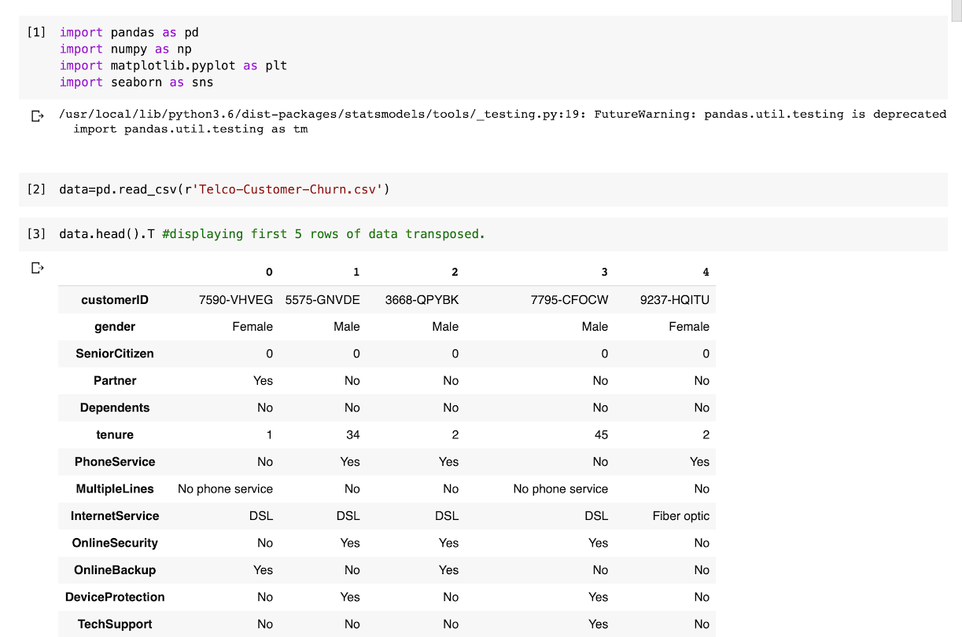
Experimental Setup
5.Sklearn.metrics: The metrics module implements functions assessing prediction error for specific purposes.Many metrics are not given names to be used as scoring values, sometimes because they require additional parameters, such as fbeta_score. In such cases, you need to generate an appropriate scoring object. The simplest way to generate a callable object for scoring is by using make_scorer. That function converts metrics into callables that can be used for model evaluation.

